Slide 1
Analysis of Environmental Inequality in California
The social factors associated with worse air pollution in Southern California
By Yu-Chun Chen & Yanyu Tao

Slide 2
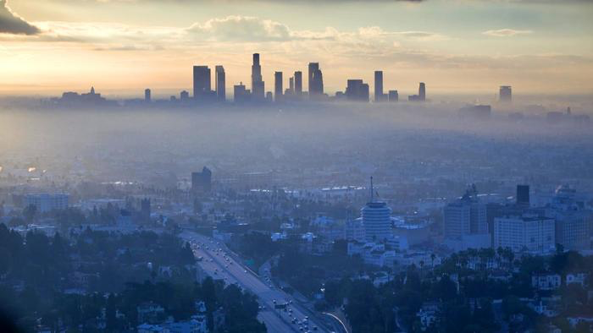
Background & Intro
Pollutant level is higher in areas with lower income
short-term exposures to ozone, nitrogen dioxide, sulphur dioxide are thought to increase the risk of respiratory diseases
Some respiratory diseases related to air pollution include Asthma, Chronic Obstructive Pulmonary Disease(COPD)
Reduction of pollution exposure will lead to a better life expectancy

Slide 3
Questions Proposed
Explore how each county’s business or factory types, average income, diseases, are related to the seriousness of air pollution in its range
We refer to Air Quality Index of NO2, SO2, O3, and CO for seriousness of air pollution
Lower avg income, higher diseases rate, higher facility emission, factory related to fossil fuel / manufacturing -> higher AQI
Notes:
Inspired by our background research, we would like to investigate the air quality in / around our own living area
Therefore, california and county as unit

Slide 4
Data Used
US Household Income Statistics
US Facility Level Air Pollution
US Pollution Data (monitoring site)
NAICS Dictionaries
Reported Asthma Cases in 2014
Reported COPD Cases in 2014
USA County Layer

Slide 5
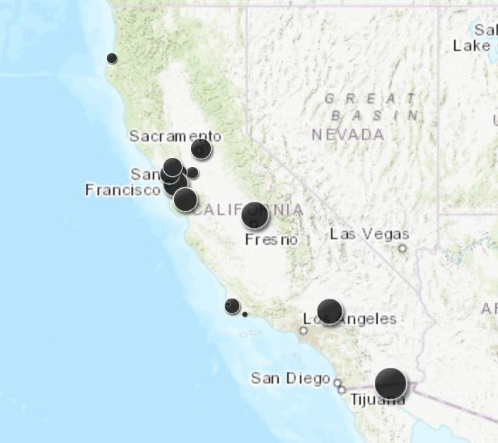
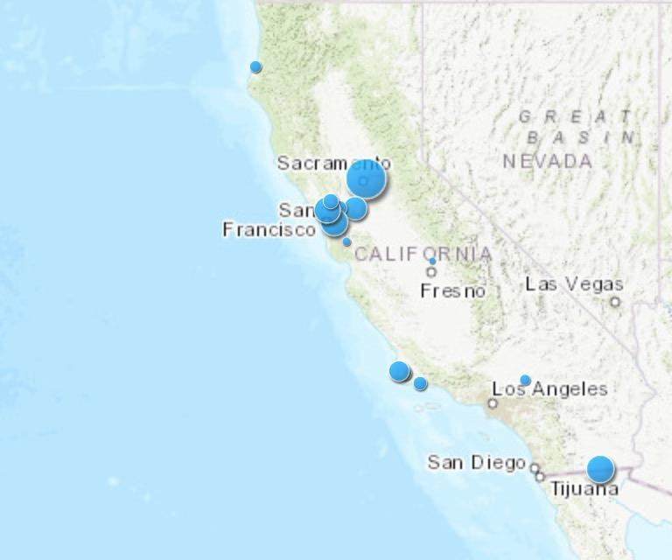
Symbol Repr - Greenhouse Gases Air Quality Index
- NO2
- SO2

Slide 6
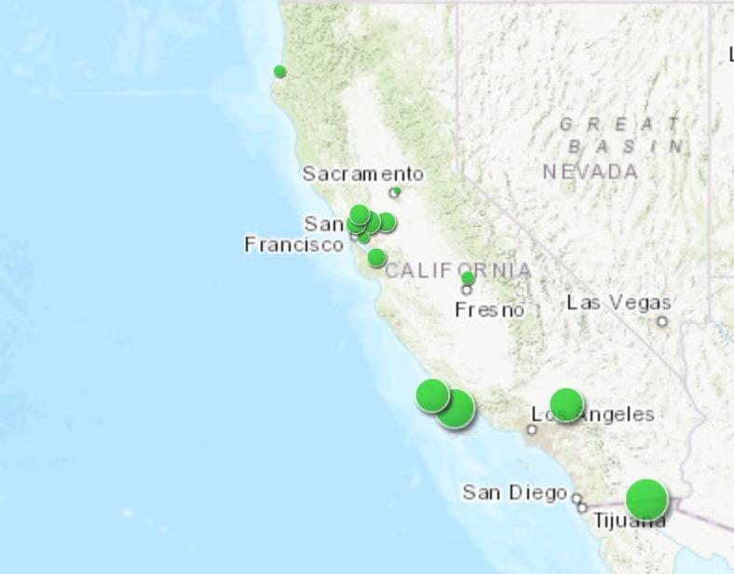
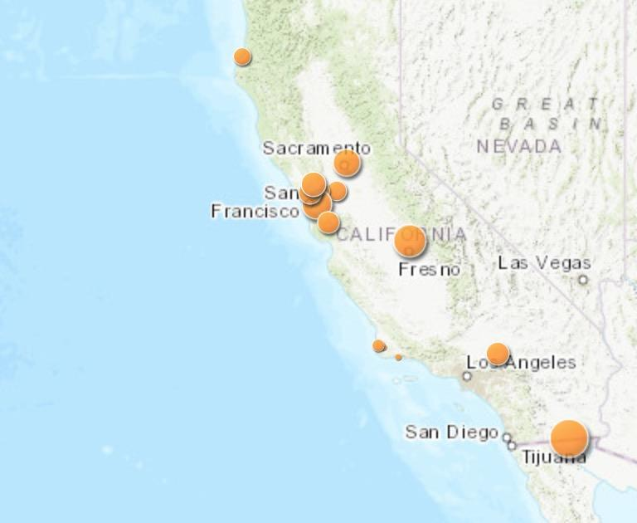
Symbol Repr - Greenhouse Gases Air Quality Index
- O3
- CO

Slide 7
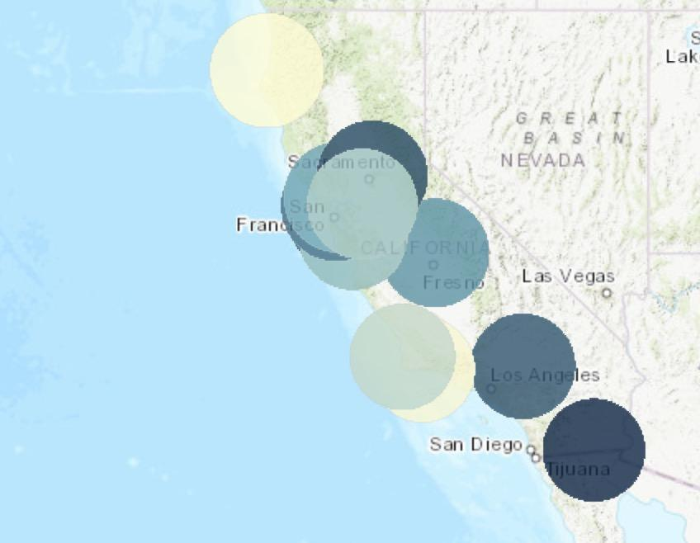
Buffered Average AQI (Normalized)
Not all counties have monitoring site
Used create_buffer to cover neighboring counties of those with monitoring site
Normalized greenhouse gases
AQI and calculated average
The darker of color the higher AQI

Slide 8
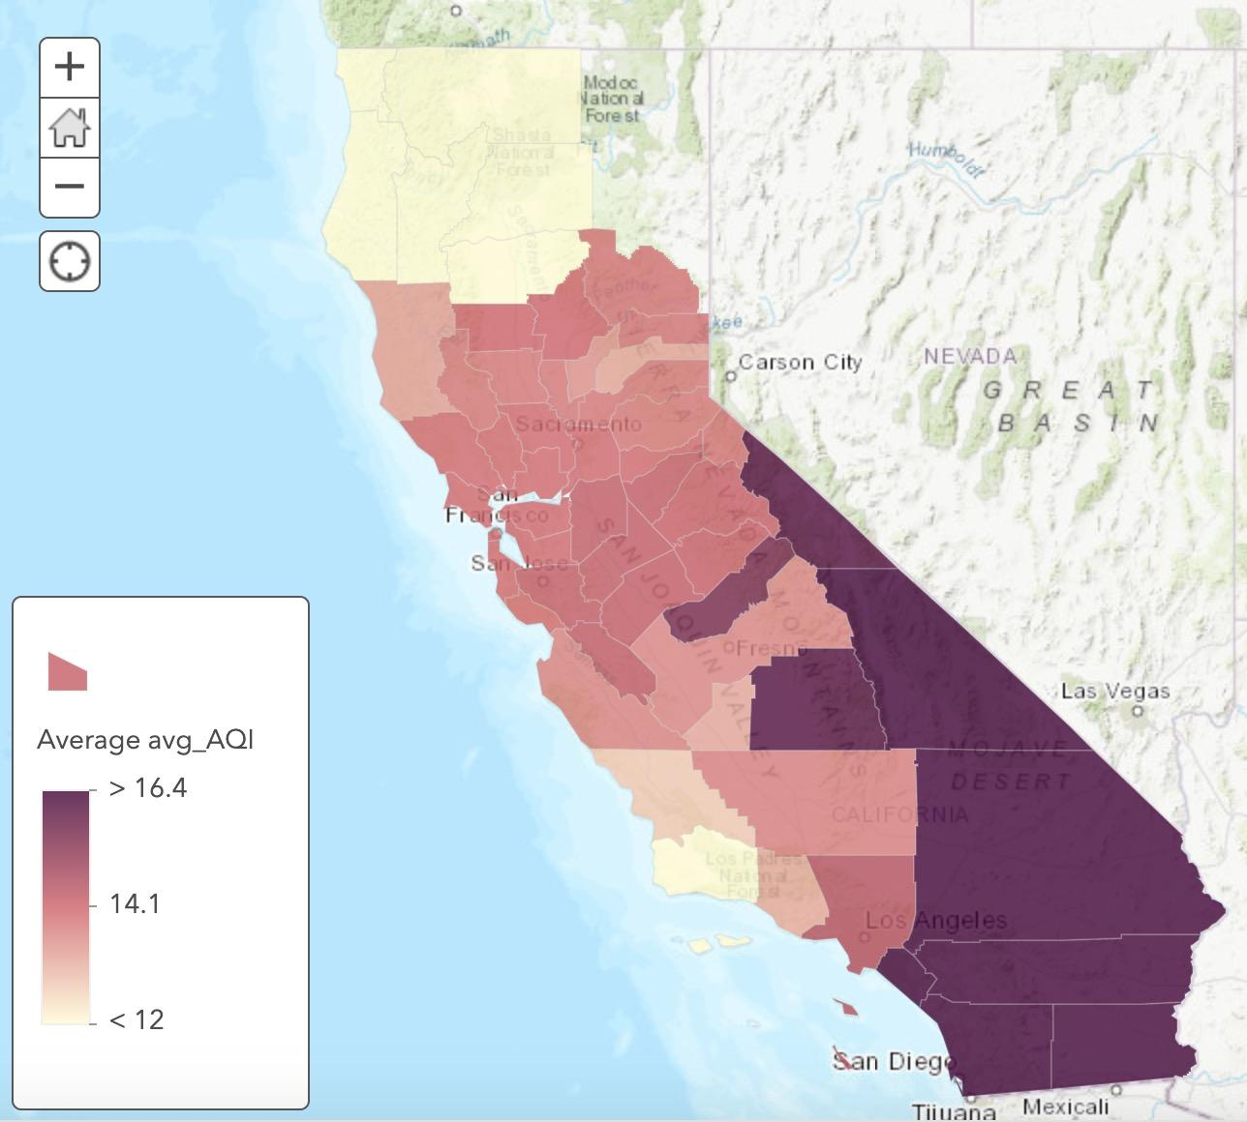
Spatial Join CA County Layer w/ buffered Layer
We can see a clear trend that the air quality become worse and worse when getting towards the Southeastern of CA

Slide 9
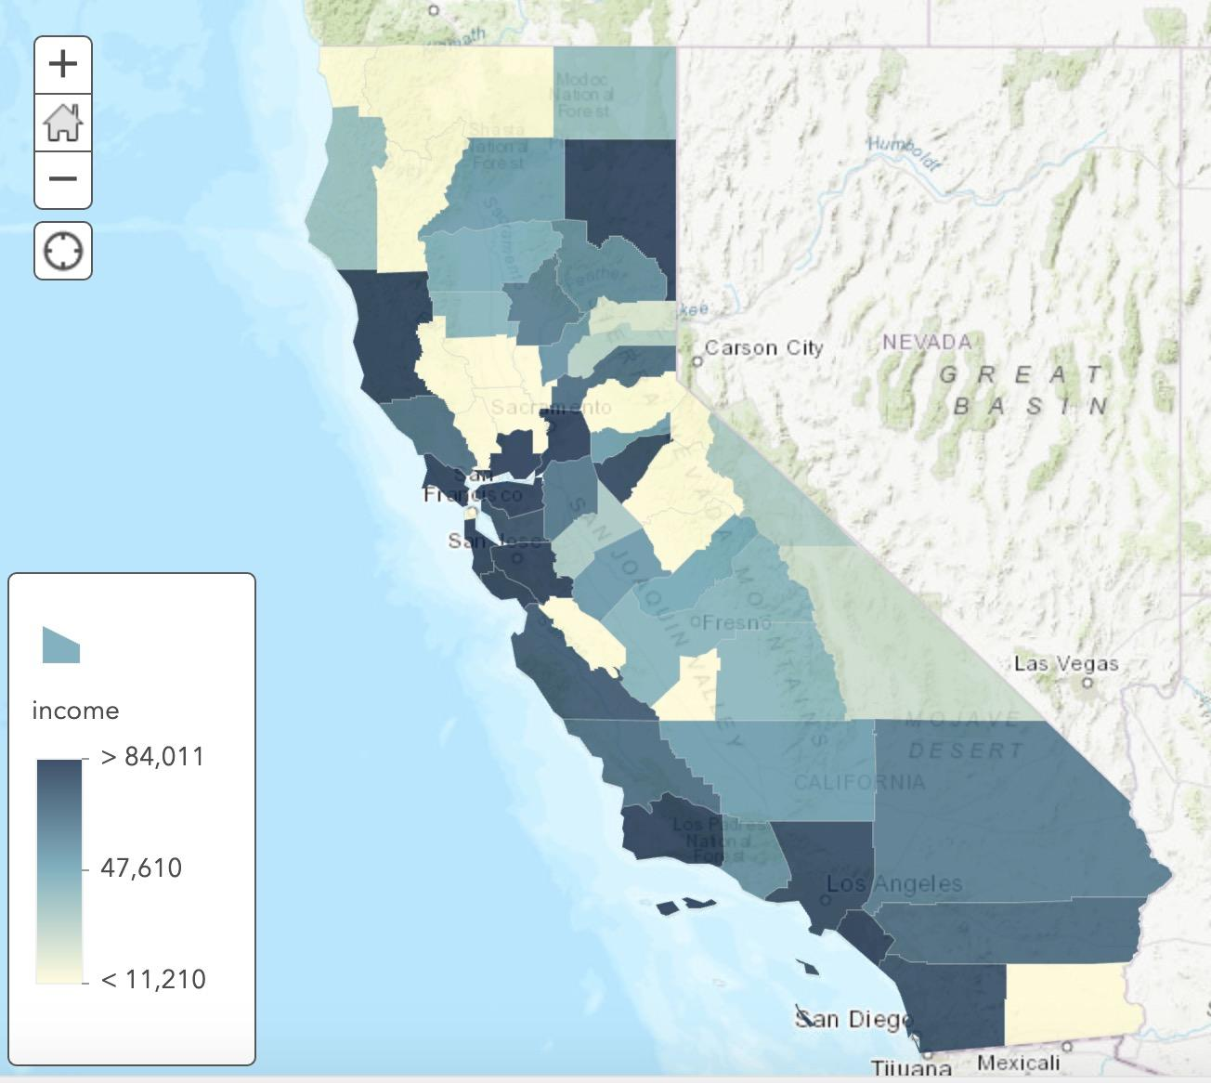
Analysis
With the finding that Southern California has worse air quality
Explore social factors interact with air quality
Local income, Facility emission, Facility type, asthma and copd rate
Image: average income by county

Slide 10
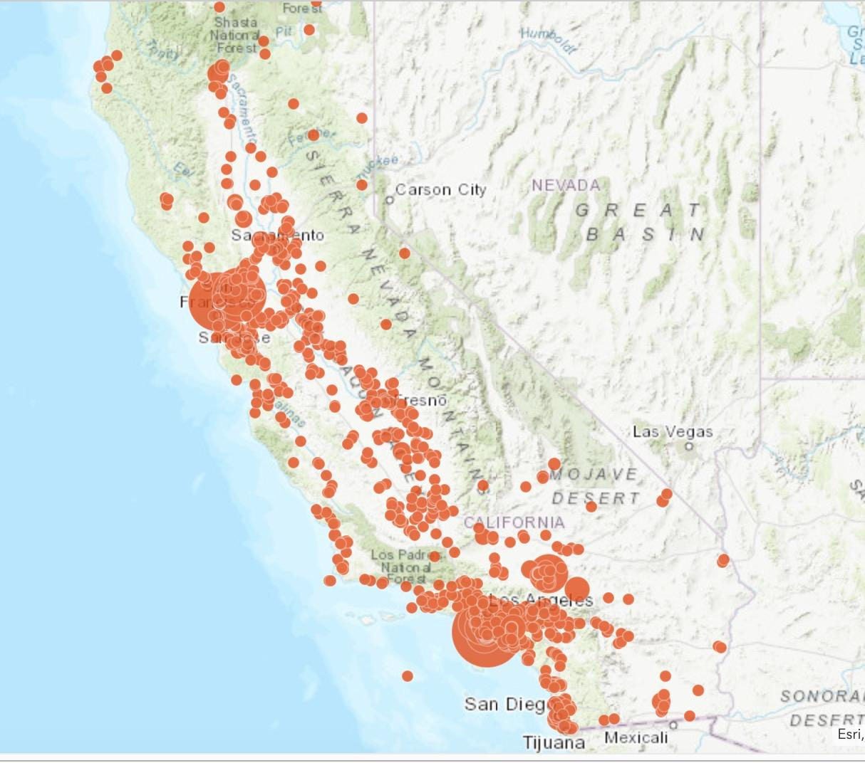
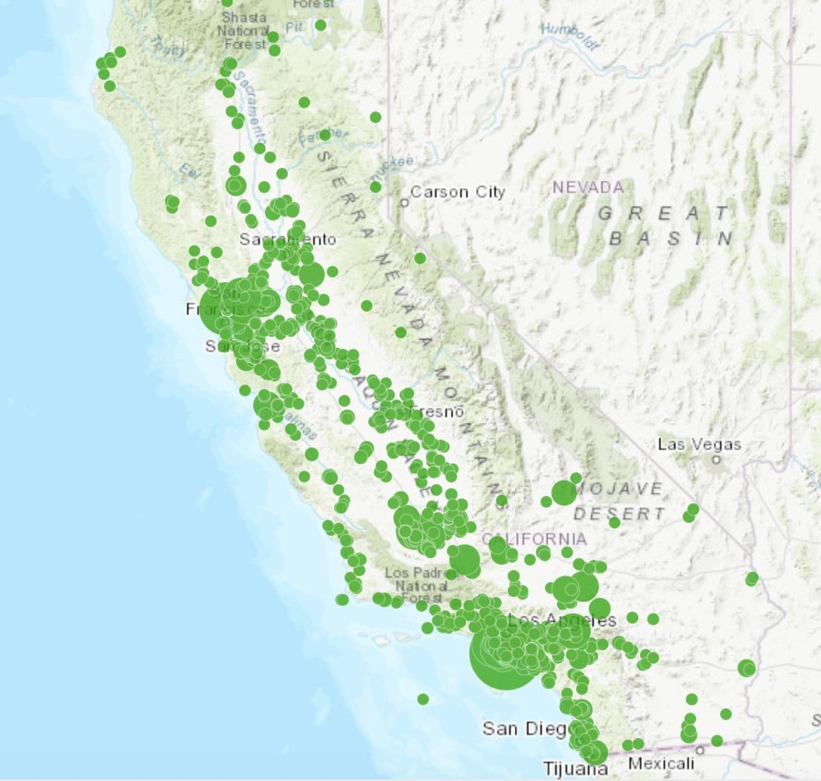
Facility TRI & GHG Emission
TRI: Toxic Release Inventory GHG: Greenhouse gas

Slide 11
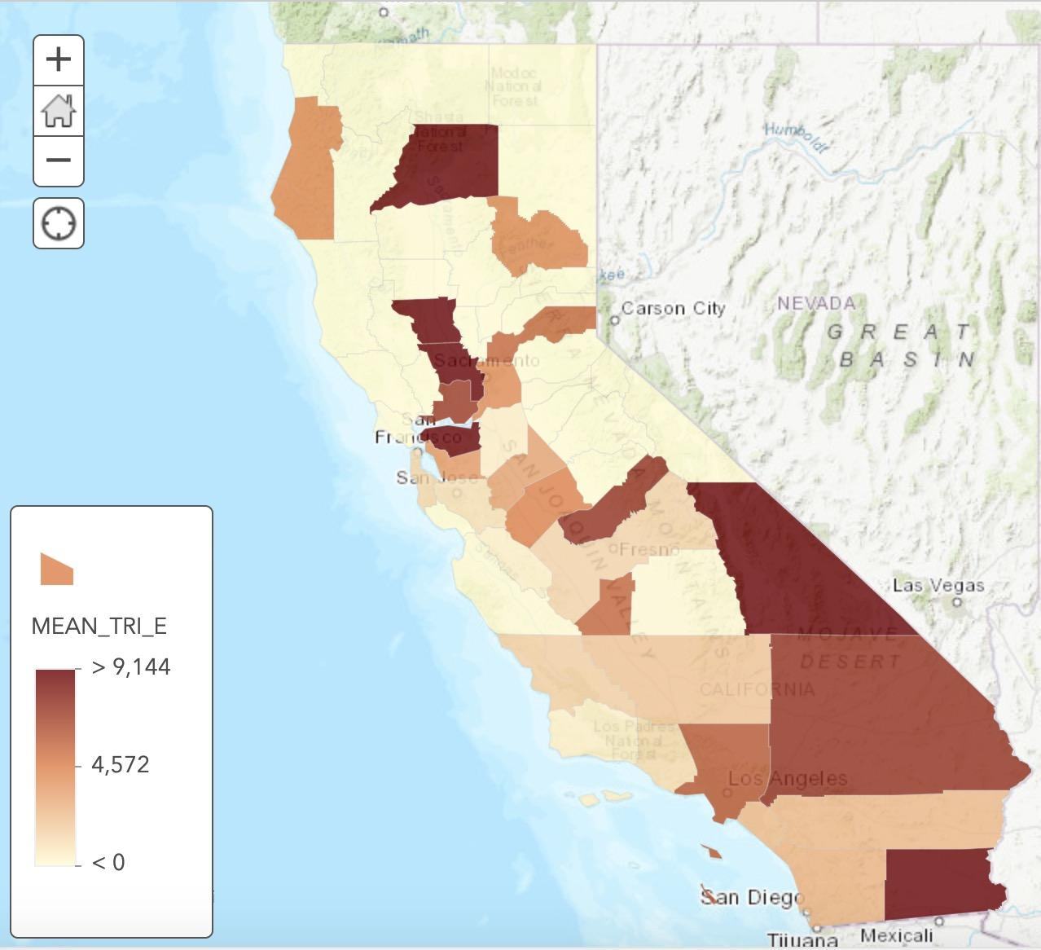
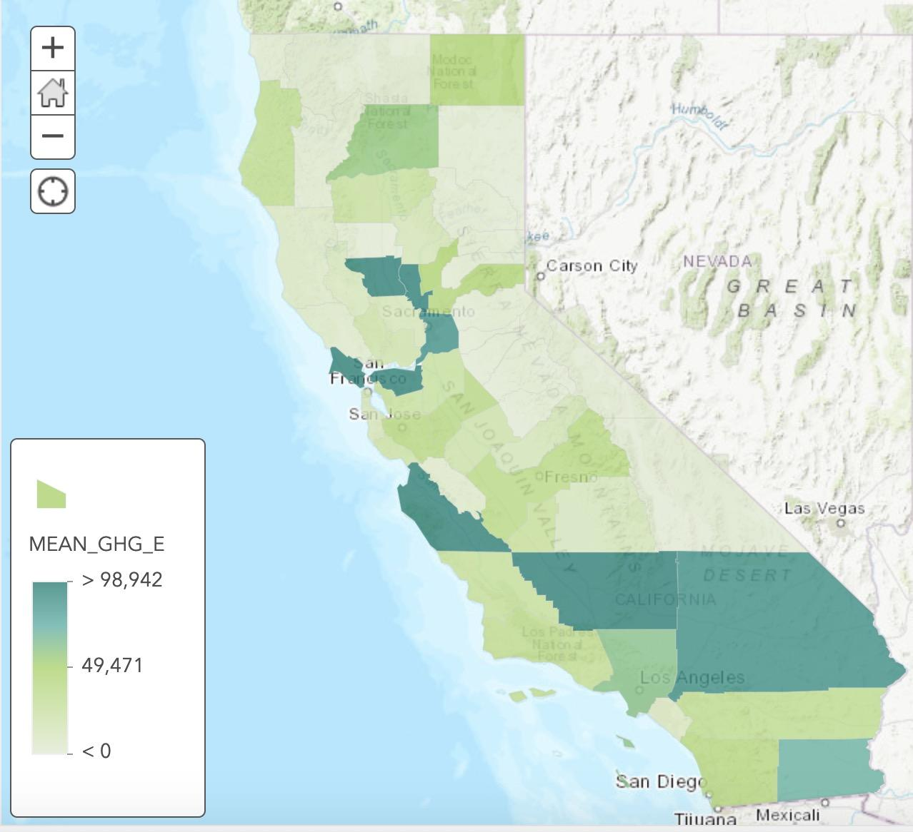
Aggregation of facilities points to counties
TRI: Toxic Release Inventory GHG: Greenhouse gas

Slide 12
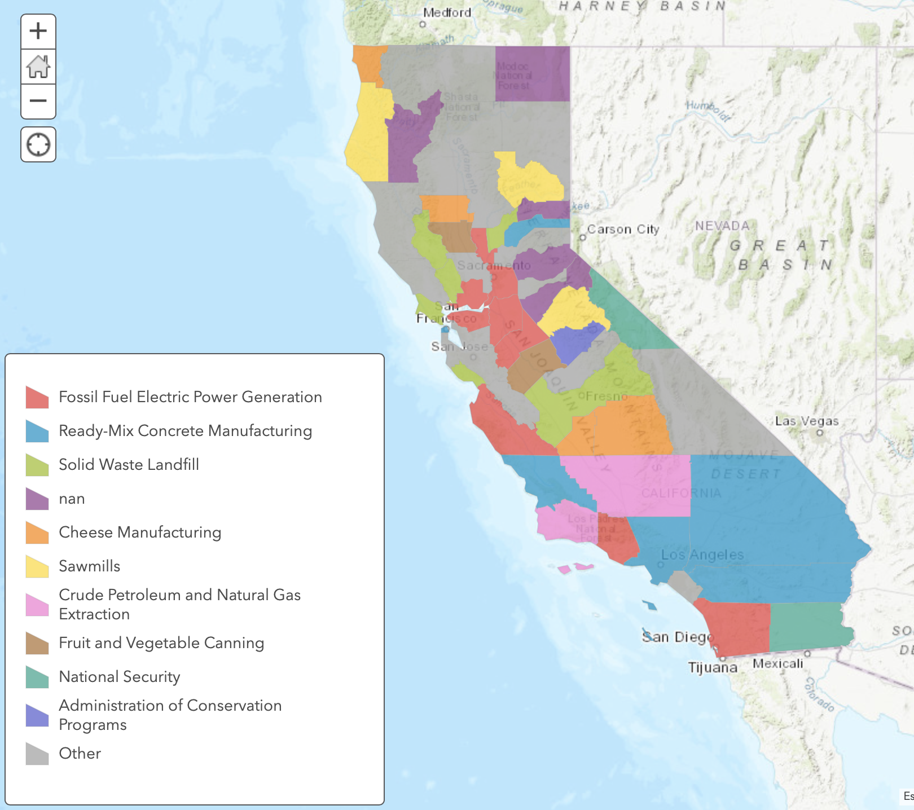
Most Common Industry Type by County

Slide 13
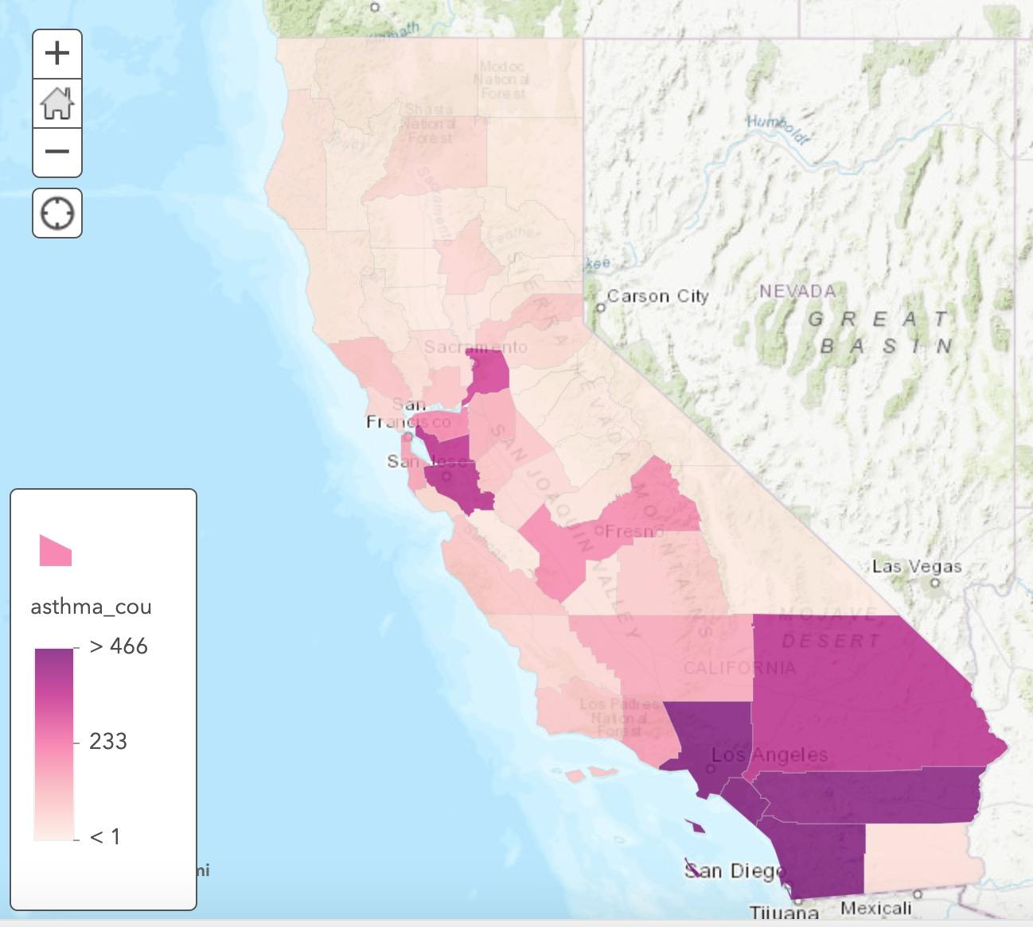
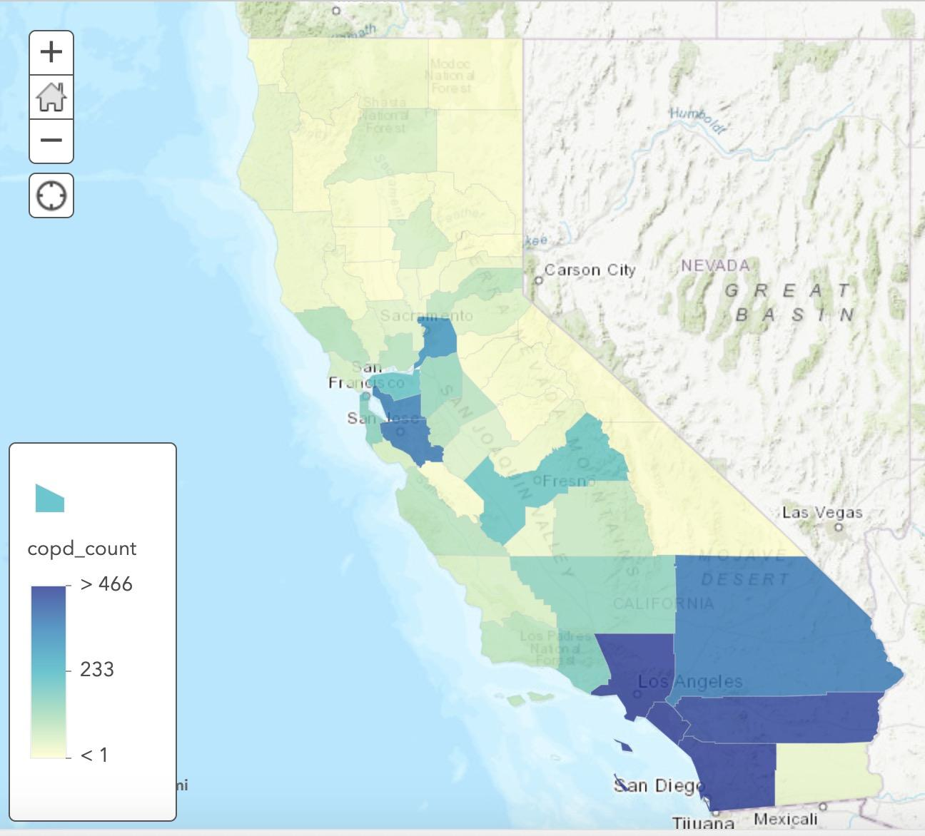
Asthma & COPD Cases Count
Asthma COPD

Slide 14
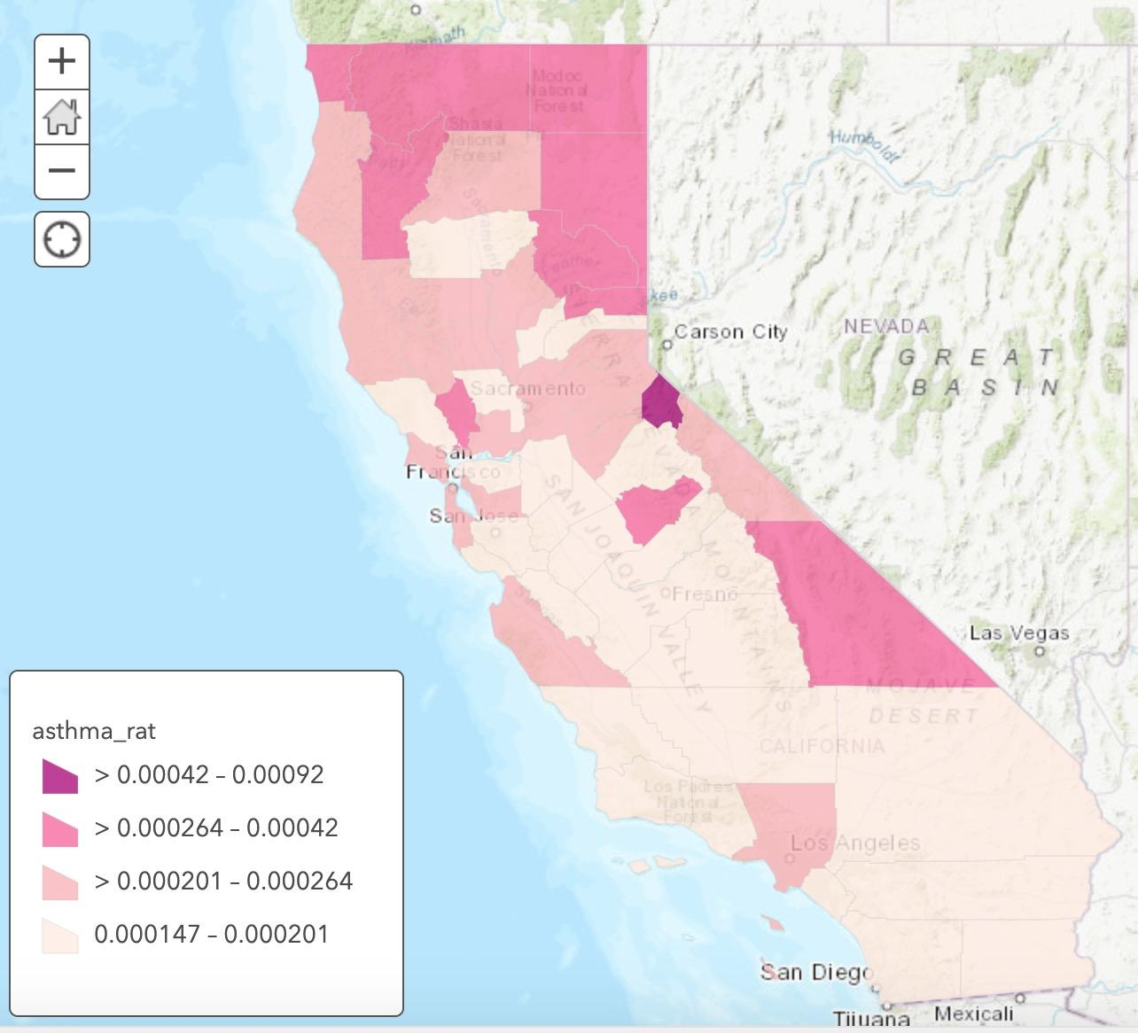
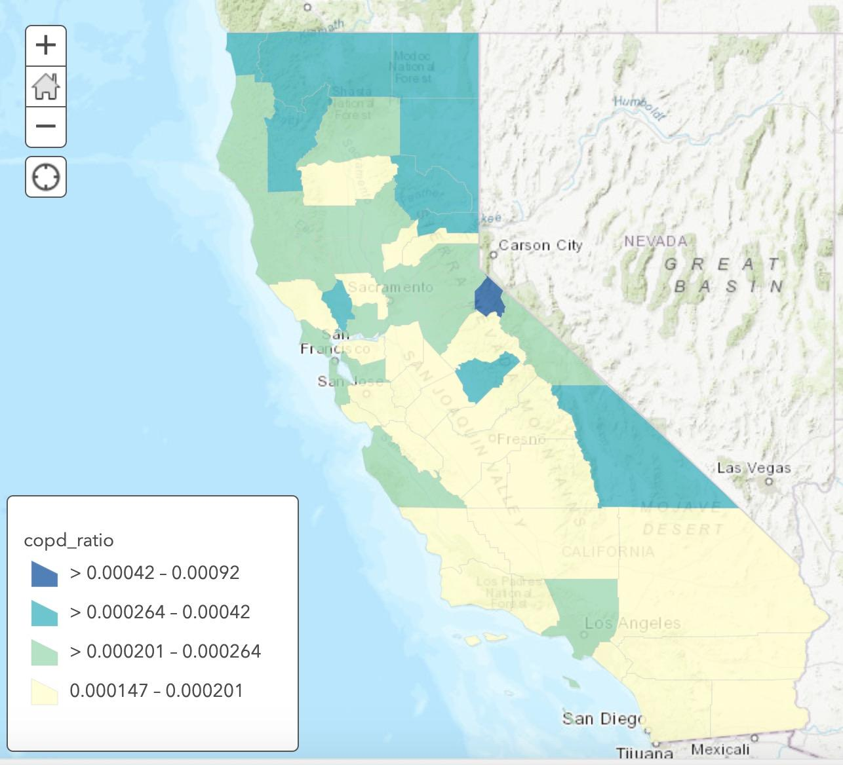
Asthma & COPD Incidence Rate
Asthma COPD

Slide 15
Train and Classify
Model used: Random Forest Classifier
Total 6 features to train
income, facility emissions of TRI & GHG, facility types, incidence rate of asthma & COPD
Divided into 4 groups
Discretize normalized average AQI into five equal-size quantiles

Slide 16
57.14%
Mean TRI Emission & Mean GHG Emission as Features

Slide 17
42.86%
Most Common Industry Type as Single Feature

Slide 18
28.57%
Income as Single Feature

Slide 19
64.29%
Incidence Rate of Asthma & Incidence Rate of COPD as Features

Slide 20
Discussion
Main industry type in each area is associated with its air quality
Limit numbers of facilities related to fossil fuels, crude petroleum, and ready-mix concrete manufacturing
Average emission of all facilities in an area is associated with air quality
Regulate TRI and GHG emission of each facility
Preprocessing before release/emission

Slide 21
Limitations of Analysis
80 miles buffer for each monitoring site
Represent overall air quality by computing average normalized AQI of all four GHG AQI
One to one spatial join of buffers and county polygons
Data for reported asthma and COPD cases in 2014
Unreported Cases?
Short term vs. long term exposure?

Slide 22
Conclusion & Future Works
Encourage local government to regulate businesses and factories
Possible further investigation with individual long term and short term exposure data, and also more monitoring sites
Research can be extended to the association of industry/health and other environmental pollution besides air pollution

Slide 23
Thank You!

